Slide 1

Decode Gaming Behaviour
Problem Statement
The main aspect of this project and the data asked.
Dataset Description
The datasets used in this project and their descriptions.
What we have to do?
The specific tasks asked and giving the results in the form of tables.

Slide 2

Problem Statement
In this internship, we will be working with a dataset related to a game. The dataset includes two tables: `Player Details` and `Level Details`.
Tools Used:
Microsoft SQL Server for writing queries asked in the tasks and giving the results in the form of a table.
Dataset:
Player Details
Level Details
From Mentorness

Slide 3
Dataset Description
The dataset includes two tables: `Player Details` and `Level Details`.
Below is a brief description of the dataset:
Player Details Table:
`P_ID`: Player ID
`PName`: Player Name
`L1_status`: Level 1 Status
`L2_status`: Level 2 Status
`L1_code`: Systemgenerated Level 1 Code
`L2_code`: Systemgenerated Level 2 Code
Level Details Table:
`P_ID`: Player ID
`Dev_ID`: Device ID
`start_datetime`: Start Time
`stages_crossed`: Stages Crossed
`level`: Game Level
`difficulty`: Difficulty Level
`kill_count`: Kill Count
`headshots_count`: Headshots Count
`score`: Player Score
`lives_earned`: Extra Lives Earned

Slide 4
What we need to do
Using the “Game Analysis.sql” file, there are 15 questions for which we have to find the answers by writing SQL queries.
Extract `P_ID`, `Dev_ID`, `PName`, and `Difficulty_level` of all players at Level 0.
Find `Level1_code`wise average `Kill_Count` where `lives_earned` is 2, and at least 3 stages are crossed.
Find the total number of stages crossed at each difficulty level for Level 2 with players using `zm_series` devices. Arrange the result in decreasing order of the total number of stages crossed.
Extract `P_ID` and the total number of unique dates for those players who have played games on multiple days.
Find `P_ID` and levelwise sum of `kill_counts` where `kill_count` is greater than the average kill count for Medium difficulty.
Find `Level` and its corresponding `Level_code`wise sum of lives earned, excluding Level 0. Arrange in ascending order of level.
Find the top 3 scores based on each `Dev_ID` and rank them in increasing order using `Row_Number`. Display the difficulty as well.
Find the `first_login` datetime for each device ID.
Find the top 5 scores based on each difficulty level and rank them in increasing order using `Rank`. Display `Dev_ID` as well.
Find the device ID that is first logged in (based on `start_datetime`) for each player (`P_ID`). Output should contain player ID, device ID, and first login datetime.

Slide 5
11. For each player and date, determine how many `kill_counts` were played by the player so far.
Using window functions
Without window functions
12. Find the cumulative sum of stages crossed over `start_datetime` for each `P_ID`, excluding the most recent `start_datetime`.
13. Extract the top 3 highest sums of scores for each `Dev_ID` and the corresponding `P_ID`.
14. Find players who scored more than 50% of the average score, scored by the sum of scores for each `P_ID`.
15. Create a stored procedure to find the top `n` `headshots_count` based on each `Dev_ID` and rank them in increasing order using `Row_Number`. Display the difficulty as well.

Slide 6
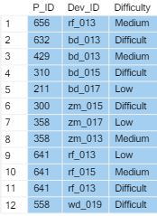
Extract `P_ID`, `Dev_ID`, `PName`, and `Difficulty_level` of all players at Level 0.
The SQL Query is below:
Select P_ID, Dev_ID, Difficulty
From level_details
Where Level=0; The result from this query:

Slide 7

2. Find `Level1_code`wise average `Kill_Count` where `lives_earned` is 2, and at least 3 stages are crossed.
The SQL Query is below:
Select L1_Code L1_code, AVG(Kill_Count) Avg_Kill_Count
From level_details
Join player_details On level_details.P_ID=player_details.P_ID
Where Lives_Earned=2 And Stages_crossed>=3
Group By L1_Code; The result from this query:

Slide 8

3. Find the total number of stages crossed at each difficulty level for Level 2 with players using `zm_series` devices. Arrange the result in decreasing order of the total number of stages crossed.
The SQL Query is below:
Select Difficulty, Sum(Stages_crossed) as Total_Stages_Crossed
From level_details
Where Level=2 And Dev_ID Like'%zm%'
Group By Difficulty
Order By Total_Stages_Crossed Desc;
The result from this query:

Slide 9
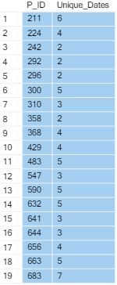
4. Extract `P_ID` and the total number of unique dates for those players who have played games on multiple days.
The SQL Query is below:
Select P_ID, Count(Distinct start_datetime) as Unique_Dates
From level_details
Group By P_ID
Having Count(Distinct start_datetime)>1;
The result from this query:

Slide 10
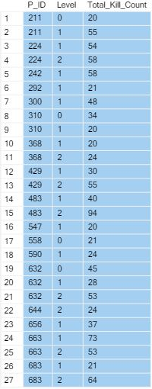
5. Find `P_ID` and levelwise sum of `kill_counts` where `kill_count` is greater than the average kill count for Medium difficulty.
The SQL Query is below:
Select P_ID, Level, Sum(Kill_Count) as Total_Kill_Count
From level_details
Where Kill_Count>
(Select Avg(Kill_Count)
From level_details
Where Difficulty Like 'Medium')
Group By Level, P_ID; The result from this query:

Slide 11
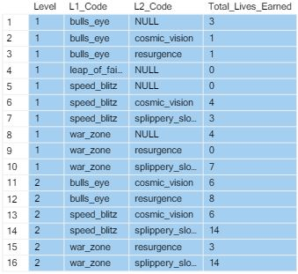
6. Find `Level` and its corresponding `Level_code`wise sum of lives earned, excluding Level 0. Arrange in ascending order of level.
The SQL Query is below:
Select Level, L1_Code,L2_Code,Sum(Lives_Earned) As Total_Lives_Earned
From level_details
Join player_details
On level_details.P_ID=player_details.P_ID
Where Level<>0
Group By Level, L1_Code, L2_Code
Order By Level Asc;
The result from this query:

Slide 12
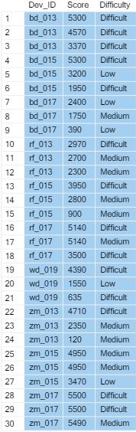
7. Find the top 3 scores based on each `Dev_ID` and rank them in increasing order using `Row_Number`. Display the difficulty as well.
The SQL Query is below:
With Ranked_Scores as
(Select *, ROW_NUMBER() Over (Partition By Dev_ID Order By Score Desc) as Rank
From level_details
)
Select Dev_ID, Score, Difficulty
From Ranked_Scores
Where Rank<=3; The result from this query:

Slide 13
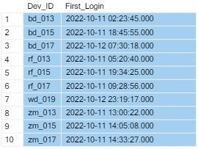
8. Find the `first_login` datetime for each device ID
The SQL Query is below:
Select Dev_ID, Min(start_datetime) as First_Login
From level_details
Group By Dev_ID; The result from this query:

Slide 14
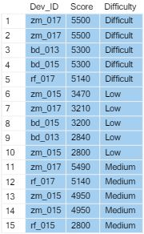
9. Find the top 5 scores based on each difficulty level and rank them in increasing order using `Rank`. Display `Dev_ID` as well.
The SQL Query is below:
With Ranked_Scores as
(Select *, Rank() Over (Partition By Difficulty Order By Score Desc) as Rank
From level_details
)
Select Dev_ID, Score, Difficulty
From Ranked_Scores
Where Rank<=5;
The result from this query:

Slide 15
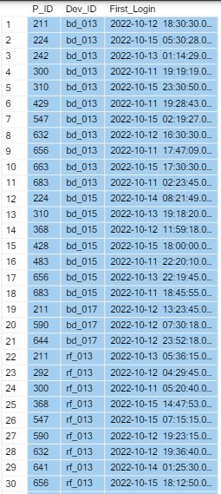
10. Find the device ID that is first logged in (based on `start_datetime`) for each player(`P_ID`). Output should contain player ID, device ID, and first login datetime.
The SQL Query is below:
Select P_ID, Dev_ID, Min(start_datetime) as First_Login
From level_details
Group By P_ID, Dev_ID; The result from this query:

Slide 16
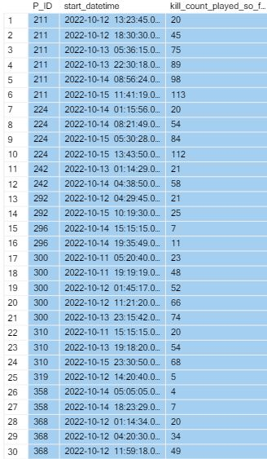
11. For each player and date, determine how many `kill_counts` were played by the player so far.
a) Using window functions
The SQL Query is below:
Select P_ID, start_datetime,
Sum(Kill_Count) Over (Partition By P_ID Order By start_datetime) as kill_count_played_so_far
From level_details; The result from this query:

Slide 17
11. For each player and date, determine how many `kill_counts` were played by the player so far.
b) Without using window functions
The SQL Query is below:
Select P_ID, start_datetime,
(Select Sum(Kill_Count) From level_details L1 Where L2.P_ID=L1.P_ID and L1.start_datetime<=L2.start_datetime) AS kill_count_played_so_far
From level_details L2
Order By P_ID, start_datetime; The result from this query:

Slide 18
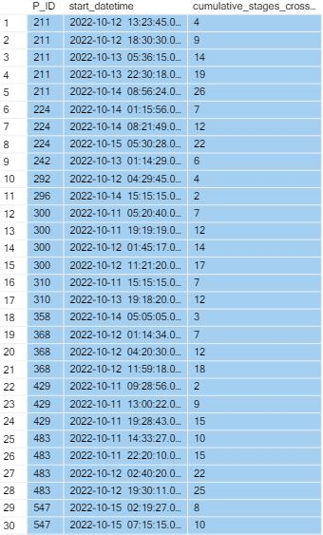
12. Find the cumulative sum of stages crossed over `start_datetime` for each `P_ID`, excluding the most recent `start_datetime`.
The SQL Query is below:
With excluded_latest_start As (
Select P_ID, Max(start_datetime) As latest_start_datetime
From level_details
Group By P_ID),
cumulative_sum As (
Select L.P_ID, L.start_datetime,
Sum(Stages_crossed) Over (Partition By L.P_ID Order By L.start_datetime) As stages_crossed
From level_details L
Join excluded_latest_start E On L.P_ID = E.P_ID
Where E.latest_start_datetime Is Null Or L.start_datetime< E.latest_start_datetime)
Select P_ID, start_datetime, stages_crossed As cumulative_stages_crossed
From cumulative_sum; The result from this query:

Slide 19
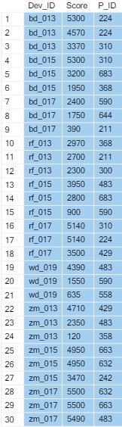
13. Extract the top 3 highest sums of scores for each `Dev_ID` and the corresponding `P_ID`.
The SQL Query is below:
With Ranked_Scores as
(Select *, Rank() Over (Partition By Dev_ID Order By Score Desc) as Rank
From level_details
)
Select Dev_ID, Score, P_ID
From Ranked_Scores
Where Rank<=3;
The result from this query:

Slide 20
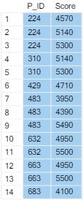
14. Find players who scored more than 50% of the average score, scored by the sum of scores for each `P_ID`.
The SQL Query is below:
Select P_ID,Score
From level_details
Group By P_ID, Score
Having Score>(Select Avg(Total_Score) * 0.5 From (Select Sum(Score) as Total_Score from level_details Group By P_ID) as avg_score)
Order By P_ID
The result from this query:

Slide 21
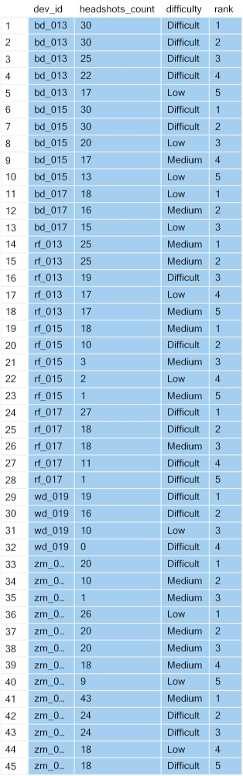
15. Create a stored procedure to find the top `n` `headshots_count` based on each `Dev_ID` and rank them in increasing order using `Row_Number`. Display the difficulty as well.
The SQL Query is below:
CREATE PROCEDURE GetTopNHeadshotsWithDifficulty
@n INT
AS
BEGIN
SELECT dev_id, headshots_count, difficulty,
ROW_NUMBER() OVER (PARTITION BY dev_id ORDER BY headshots_count DESC) AS rank
FROM (
SELECT Dev_ID, Headshots_Count, Difficulty,
ROW_NUMBER() OVER (PARTITION BY Dev_ID ORDER BY Headshots_Count DESC) AS rnk
FROM level_details
) AS ranked
WHERE rnk <= @n
END
Exec GetTopNHeadshotsWithDifficulty @n=5 The result from this query:

Slide 22
Conclusion
Our Project harnessed Game Analysis data, leveraging SQL for robust database management. We meticulously prepared and analysed the data using SQL, addressing 15 key problem statements.
These insights, encompassing player profile, performance and retention strategies. Our project emphasizes on managing large datasets and systematic analysis.
The outcomes of this project hold significant potential to inform future strategies and drive decision-making, showcasing the value of rigorous data analysis with SQL environment.

